Slide 1
WebGPU
The Next Generation Graphics API on the Web
邵嘉炜 Intel Web Graphics Team
GDG Beijing jiawei.shao@intel.com

Slide 2
The Speaker
Working on GPU-related projects in Chromium after joining Intel at 2016
Started making contributions to WebGPU since 2018
Chromium Committer

Slide 3

Agenda
What is WebGPU
Current Status of WebGPU
The Future of WebGPU

Slide 4
WebGPU
The next generation Graphics API on Web
WebGPU is a new API that exposes the capabilities of GPU hardware for the Web.
W3C “GPU for the Web” Community Group was set up in 2017Q1
Now WebGPU is being developed in W3C “GPU for the Web” Working Group
Co-chairs: Kelsey Gilbert (Mozilla) and Corentin Wallez (Google)
The members of the CG include Google, Apple, Microsoft, Mozilla, Intel, etc.
The current practice in accelerated graphics for the Web Platform is to use WebGL

Slide 5



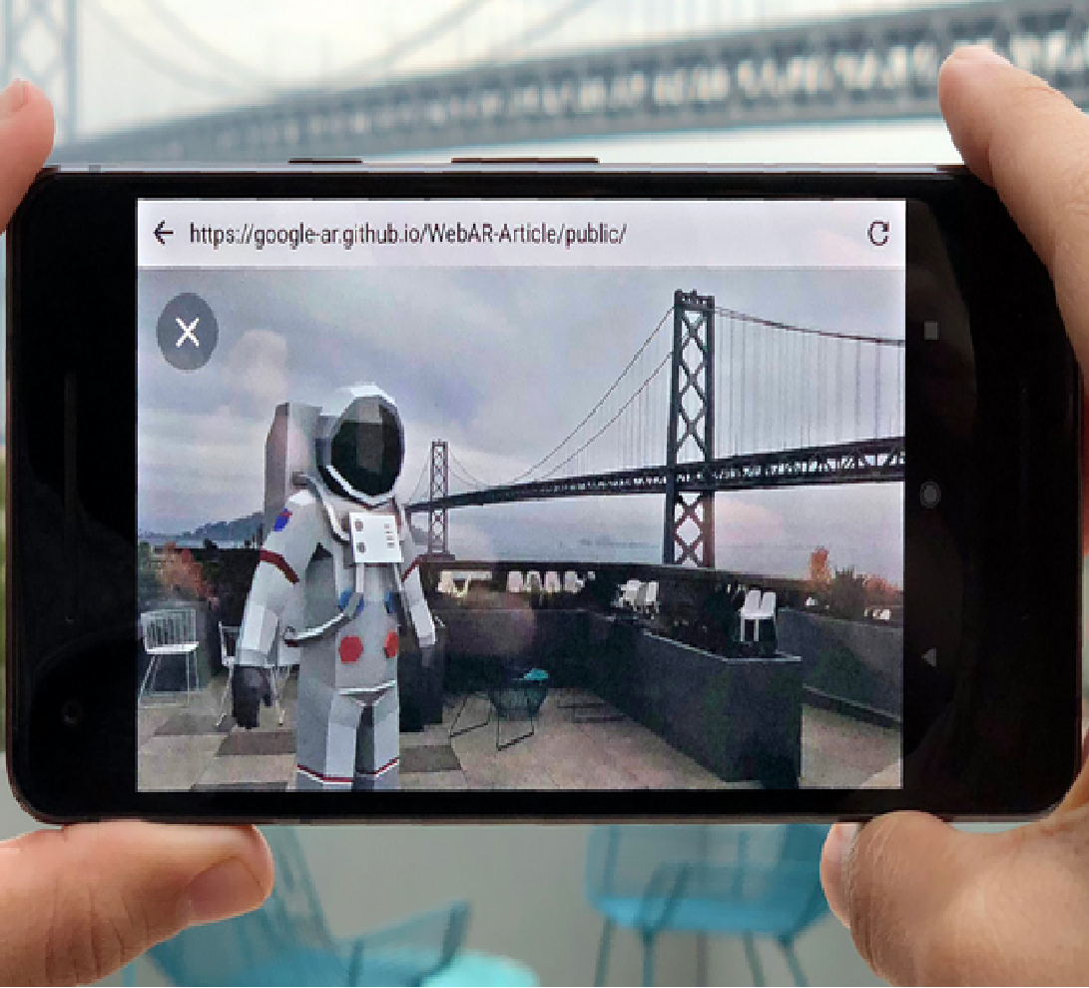
WebGL
The current Web Graphics standard
Where we are using WebGL
WebGL is a Web standard for a low-level 3D graphics API
WebGL stays very close to the related OpenGL ES specification
The Khronos Group started developing WebGL in 2009
WebGL 2.0 is supported by all the major Web browsers after Safari 15 enables it by default in September 2021.
3D Model Display
Geographic Data Visualization
Scientific Visualization
WebXR

Slide 6



WebGL Issues
WebGL is late
OpenGL 4.1 (2010.6)
2000
2005
2010
2015
2020
2022
2025
OpenGL 1.0 (1992)
OpenGL 2.0 (2004.9)
OpenGL 3.2 (2009.8)
OpenGL 4.3 (2012.8)
OpenGL ES 2.0 (2007.3)
OpenGL ES 3.0 (2012.8)
OpenGL ES 3.1 (2012.8)
WebGL 1.0 (2011.3)
WebGL 2.0 (2017.1)
Next-Generation Graphics APIs
Metal
(Apple,
2014.6)
Vulkan 1.0
(Khronos Group, 2016.2)
OpenGL is 29 years old
WebGL 2.0 exposes OpenGL ES 3.0 API (released at 2012)
D3D12
(Microsoft, 2015.7)

Slide 7
OpenGL
OpenGL has heavy historical burden
glViewport(0, 0, w, h);
glMatrixMode(GL_PROJECTION);
glLoadIdentity();
gluOrtho2D (0.0, 1.0, 0.0, 1.0 * h / w);
glEnable (GL_BLEND);
glBlendFunc (GL_SRC_ALPHA, GL_ONE_MINUS_SRC_ALPHA);
glShadeModel (GL_FLAT);
glBegin (GL_TRIANGLES);
glColor4f(1.0, 1.0, 0.0, 0.75);
glVertex3f(0.1, 0.9, 0.0);
glVertex3f(0.1, 0.1, 0.0);
glVertex3f(0.7, 0.5, 0.0);
glEnd();
const char* vsString = R"(
uniform mat4 projection;
attribute vec4 v_position;
void main() {
gl_Position = projection * v_position;
})";
const char* fsString = R"(
precision mediump float;
void main() {
gl_FragColor = vec4(1.0, 0.0, 0.0, 1.0);
})“;
// Compile and link program with vsString and fsString
glUseProgram(program);
glEnable (GL_BLEND);
glBlendFunc (GL_SRC_ALPHA, GL_ONE_MINUS_SRC_ALPHA);
glBindBuffer(GL_ARRAY_BUFFER, vertexBuffer);
glVertexAttribPointer(0, 4, GL_FLOAT, GL_FALSE, 0, nullptr);
glDrawArrays(GL_TRIANGLES, 0, 3);
Before OpenGL 2.0:
Fixed-function only
States are tracked separately and globally
GL calls affect global states at once
After OpenGL 2.0 (WebGL):
More Stages are programmable
States are still tracked separately and globally
GL calls still affect global states at once

Slide 8
WebGL Issues
It is hard for WebGL to move forward
Apple deprecated OpenGL / ES (2018.6)
Safari supports WebGL 2.0 on top of Metal (2021.9)
OpenGL 4.1 (2010.6)
2000
2005
2010
2015
2020
2022
2025
OpenGL 1.0 (1992)
OpenGL 2.0 (2004.9)
OpenGL 3.2 (2009.8)
OpenGL 4.3 (2012.8)
OpenGL ES 2.0 (2007.3)
OpenGL ES 3.0 (2012.8)
OpenGL ES 3.1 (2012.8)
WebGL 1.0 (2011.3)
WebGL 2.0 (2017.1)
Next-Generation Graphics APIs
Apple only supports OpenGL 4.1 (< 4.3) and OpenGL ES 3.0 (< 3.1) with no support of Compute Shader
Apple deprecated OpenGL and OpenGL ES in 2018.6
It takes huge efforts to support WebGL on top of Metal
Microsoft released D3D12 Ultimate in 2020.11
Metal
(Apple,
2014.6)
Vulkan 1.0
(Khronos Group, 2016.2)
D3D12
(Microsoft, 2015.7)
D3D12 Ultimate
(Microsoft, 2020.11)

Slide 9
WebGL Issues
The opportunities for WebGPU
WebGL is based on OpenGL ES, an API with heavy historical burden
States are tracked separately and globally
High cost in driver
Bad support of multi-threading
Doesn’t map well with modern GPU architecture
Extra cost in the translation from WebGL to non-GL-like graphics APIs
New GPU features will always be better supported on the next-generation graphics APIs
Metal (Apple, 2014)
D3D12 (Microsoft, 2015)
Vulkan (the Khronos Group, 2016)

Slide 10
WebGPU
A new API on the next-generation native graphics APIs
WebGPU is designed to be easily implemented on D3D12 (Microsoft), Metal (Apple) and Vulkan (the Khronos Group)
Include both API and Shading Language
Reduce CPU overheads
Good support of multi-threading
Take advantage of the modern GPU architectures
Expose the ability of GPU computing

Slide 11
WebGPU reduces CPU overheads
Fewer costs in Drivers / Implementations
WebGL
WebGPU
WebGL APP
WebGPU APP
Chromium / Blink
It is easy and straightforward to implement WebGL on OpenGL / OpenGL ES with expensive error checking inside the drivers
It brings extra cost in the translation from WebGL to non-GL-like graphics APIs.
WebGPU are running on D3D12, Metal and Vulkan with minimal error checking inside drivers.
WebGL Runtime
(ANGLE)
WebGPU Runtime
(Dawn)
OpenGL Backend
Non-OpenGL Backends
OpenGL / ES
D3D11
D3D12 / Metal / Vulkan

Slide 12
WebGPU reduces CPU overheads
Pipeline Object
WebGL
WebGPU
Pipeline State
Program
(Vertex shader and Fragment Shader)
Vertex shader
glUseProgram
Fragment shader
In WebGL, all the pipeline states are set and tracked globally and separately.
In WebGPU most of the pipeline states are pre-compiled into one pipeline object to allow GPU to pre-process all the dependent settings.
The pipeline states can be switched by simply one API call.
glDepthFunc
Depth test
Depth test
glBlendFunc
Blending
Blending
glDrawBuffers
Framebuffer Write
Framebuffer Write

Slide 13
Multi-threading in WebGPU
Command Buffer
CPU Thread 1
…
CommandEncoder.finish()
CommandBuffer1
Cmd
Cmd
Cmd
In WebGL all the commands are affecting the context immediately.
In WebGPU the commands must be first recorded into a GPUCommandBuffer on CPU, which won’t be executed until they are submitted to a GPUQueue.
The commands can be recorded in parallel in Web Workers as is required by WebGPU SPEC.
…...
CommandEncoder.finish()
CPU Thread N
Cmd
Cmd
…
Cmd
CommandBufferN
CommandBuffer1
CommandBuffer2
…
CommandBufferN
Queue.submit()
Queue

Slide 14
WebGPU Compute
Compute Shader
Uniform Buffers
Read-only
Storage Buffers
Read-only
Storage Textures
Sampled Textures
Storage Buffers
Compute Shader
Dispatch Cmd
WebGPU brings general-purpose computing (GPGPU) to Web with Compute Shaders
Access Shared Memory
Arbitrary Read / Write to Storage Buffers
Arbitrary Write to Storage Textures
Atomic Functions
Barriers
Atomic Functions
Barriers
Storage Textures
Shared Memory
Only Available in WebGPU
Available in
WebGL & WebGPU

Slide 15
WebGPU Compute
Shared Memory
// Shader code
layout (local_size_x = 64) in;
// Data in global memory
layout (set = 0, binding = 0) buffer {
uvec4 input_data[];
} buf0;
// Data in shared memory
shared uvec4 shared_data[64];
void main() {
shared_data[gl_LocalInvocationID.x] = buf0.numbers[gl_LocalInvocationID.x];
memoryBarrierShared();
...
}
GPU
Unlike other shaders, compute shaders can explicitly make use of GPU Shared Memory.
On modern GPUs Shared Memory is a piece of on-chip memory with much lower latency and higher performance than global memory.
Data in shared memory is shared among all the threads in a work group.
GPU “block”
CU
ALU | ALU | ALU | ALU | ALU | ALU | ALU | ALU
Reg | Reg | Reg | Reg | Reg | Reg | Reg | Reg
ALU | ALU | ALU | ALU | ALU | ALU | ALU | ALU
Reg | Reg | Reg | Reg | Reg | Reg | Reg | Reg
Fixed Function
(FF)
Shared Memory
“CU”: Compute Unit
“ALU”: Arithmetic Logic Unit
“Reg” Register
GPU Global Memory
Arbitrary global memory read and writes from ALUs

Slide 16
WebGPU Compute
Example: TensorFlow.js Operator “Sum”
WebGL
4
5
3
6
2
5
1
7
…
=
33
Iterate evey number in one GPU thread
WebGPU
Global Memory
Compared with the WebGL version (with Vertex and Fragment shaders), in WebGPU version (with Compute Shaders)
Data access is much more flexible
Intermediate data can be shared among multiple working threads in shared memory with high efficiency
4
5
3
6
2
5
1
7
Thread
+
+
+
+
Shared Memory
6
10
4
13
Thread
+
+
10
23
Thread
+
=
33

Slide 17
Agenda
What is WebGPU
Current Status of WebGPU
The Future of WebGPU

Slide 18
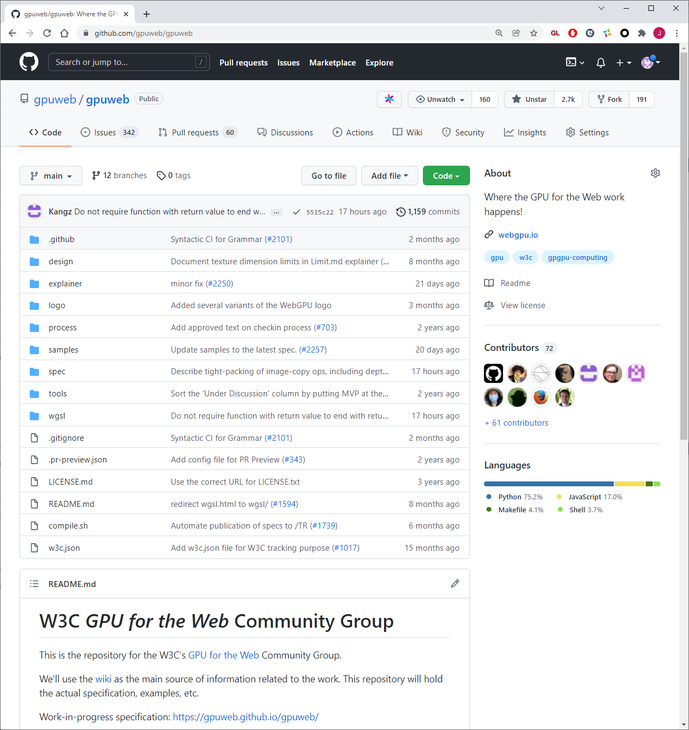
WebGPU Standardization
WebGPU SPEC is still under development in W3C “GPU for the Web” WG
The target of the WG is shipping WebGPU V1.0

Slide 19

WebGPU in Chromium
WebGPU APP
WebGPU API
Renderer Process
DawnWire (IPC)
GPU Process
DawnNative
D3D12
Metal
Vulkan
D3D12 Driver
Metal Driver
Vulkan Driver

Slide 20
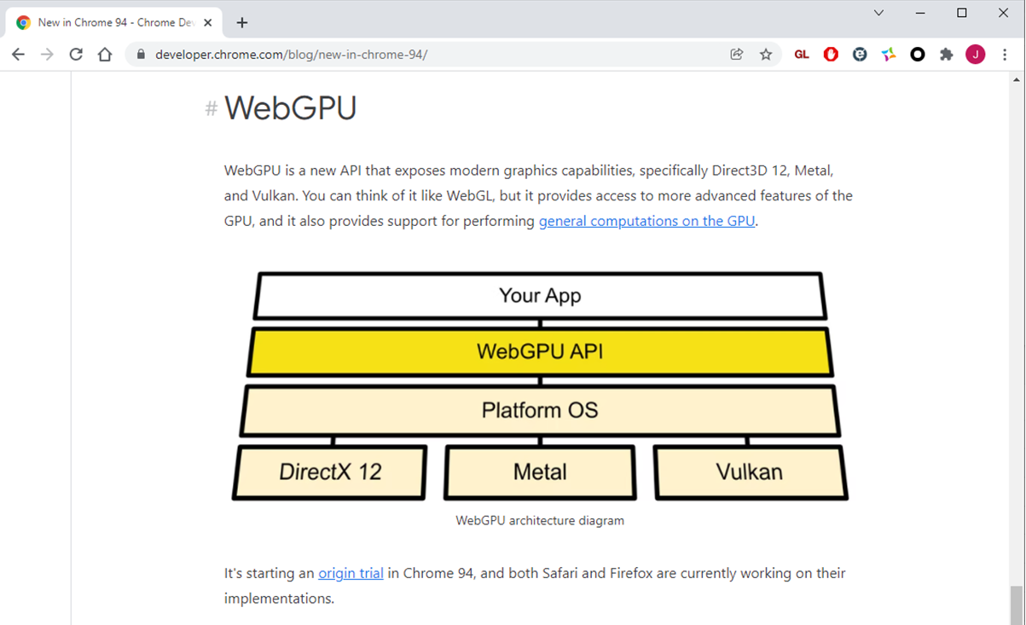
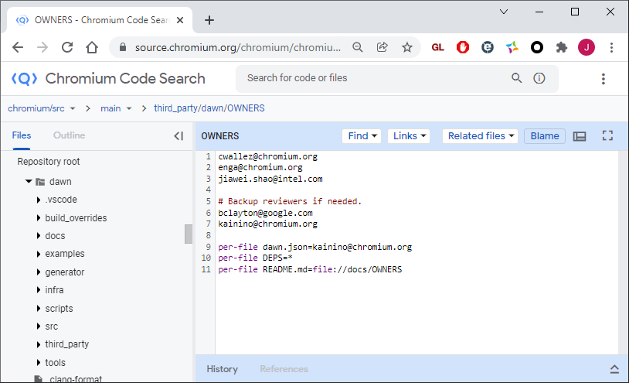
WebGPU in Chrome
WebGPU Origin Trial (OT)
WebGPU is available as Origin Trial on desktop GPUs since Chrome 94
But the WebGPU API is still unstable and evolving all the time

Slide 21

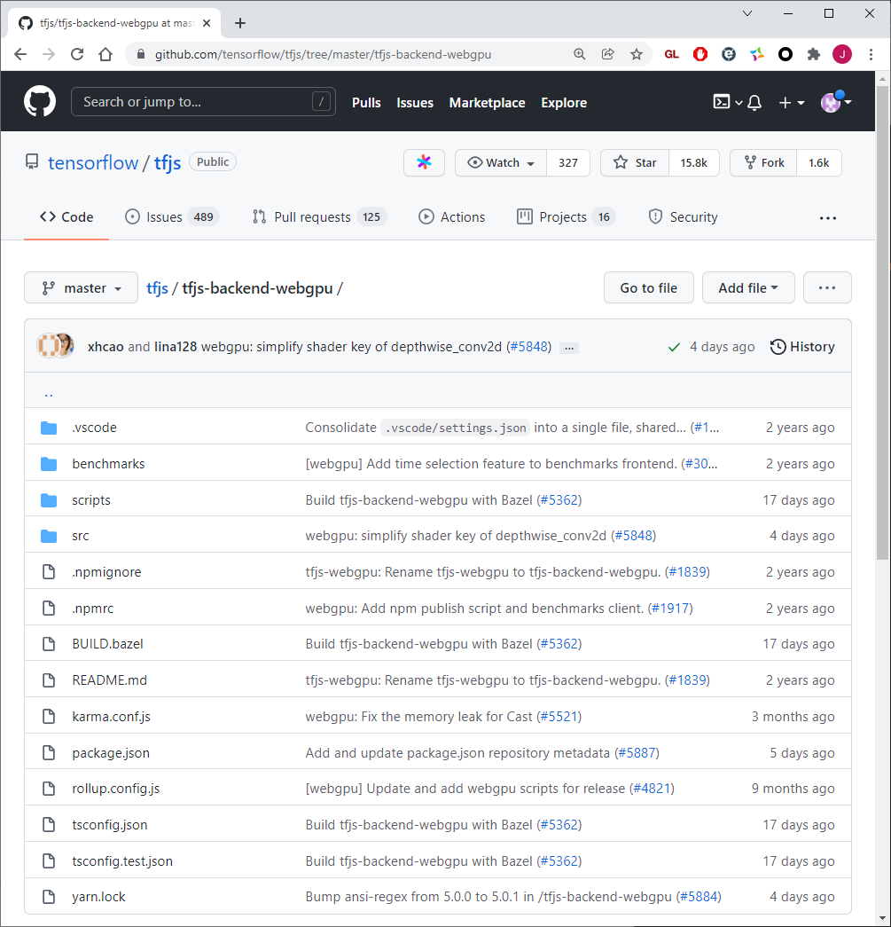
Projects adopting WebGPU
TensorFlow.js
Intel is maintaining the WebGPU backend of TensorFlow.js
Performance Optimizations
Propose new WebGPU Features about Tensorflow.js
Daily test on Performance and Conformance

Slide 22
Agenda
What is WebGPU
Current Status of WebGPU
The Future of WebGPU

Slide 23
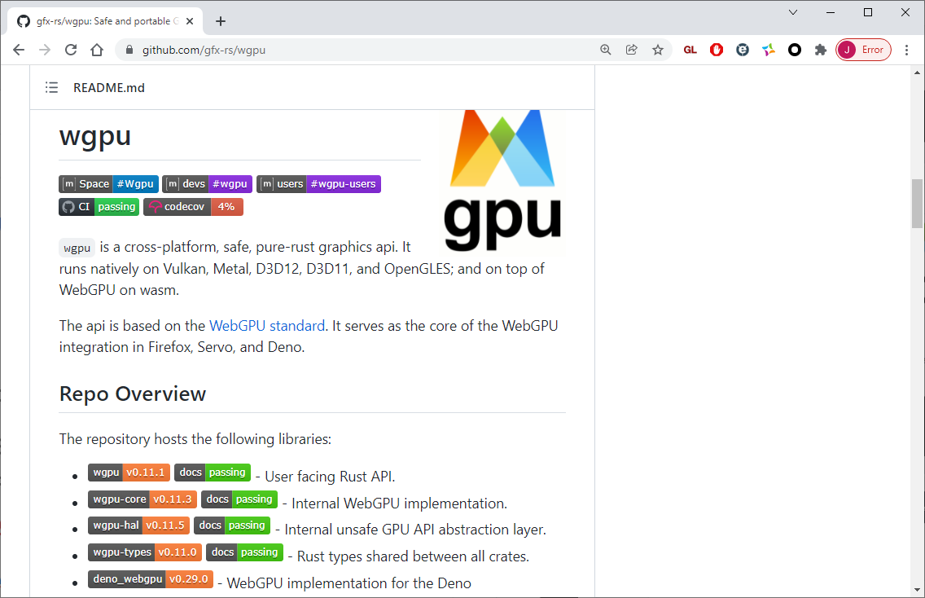
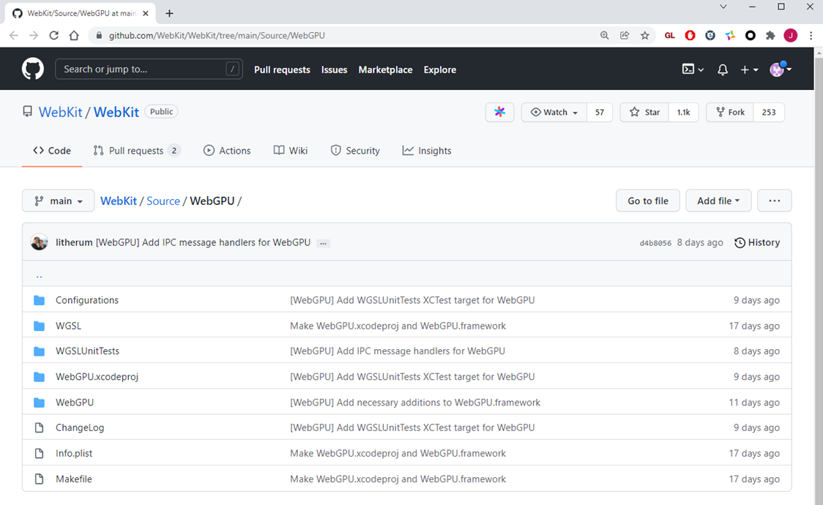
WebGPU is Coming!
Implementations on other Browsers
Project gfx-rs is the open-sourced WebGPU implementation for Firefox.
Apple is implementing WebGPU in WebKit for Safari.
Edge is based on Chromium but hasn’t enabled WebGPU yet.

Slide 24
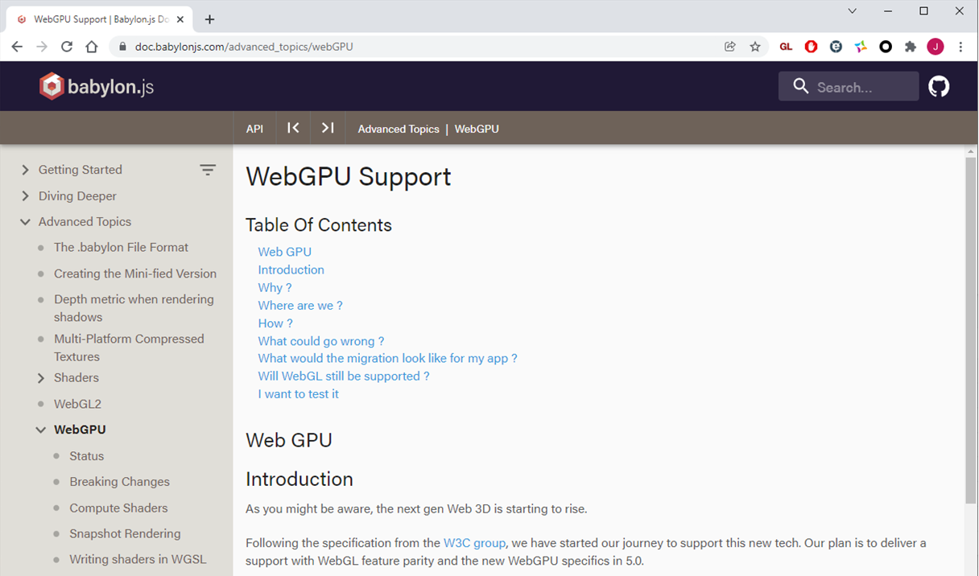
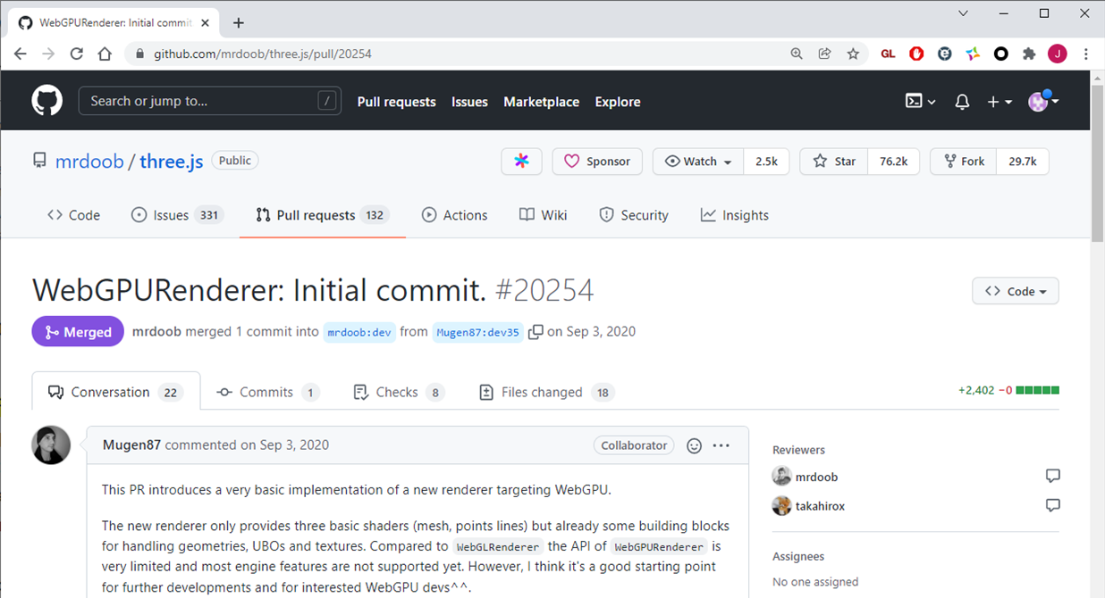
WebGPU is Coming!
Important 3D Web Frameworks
Babylon.js team planned to officially support WebGPU in 5.0.
Three.js has started implementing its WebGPU backend.

Slide 25
WebGPU is Coming!
More advanced GPU features are waiting for WebGPU
Multi-Queue
Multi-Adapter
D3D12 Ultimate Features
Variable Rate Shading
Sampler Feedback
Mesh Shading
Ray Tracing
Subgroup / Float16 / DP4A / Systolic Array …

Slide 26
WebGPU is Coming!
Useful Links
WebGPU SPEC
Github Repository: https://github.com/gpuweb/gpuweb
Online versions
https://gpuweb.github.io/gpuweb/ (API)
https://gpuweb.github.io/gpuweb/wgsl/ (WebGPU Shading Language)
W3C “GPU for the Web” CG mailing list: public-gpu@w3.org
Chromium Issue Trackers
Dawn: https://bugs.chromium.org/p/dawn/issues/list
Blink / WebGPU: https://bugs.chromium.org/p/chromium/issues/list?q=component%3ABlink%3EWebGPU
TensorFlow.js (WebGPU Backend): https://github.com/tensorflow/tfjs/tree/master/tfjs-backend-webgpu
Babylon.js (Issue Tracker for WebGPU Backend): https://github.com/BabylonJS/Babylon.js/issues/6443
Three.js: https://github.com/mrdoob/three.js

Slide 27
Thank You!
邵嘉炜
GDG Beijing
jiawei.shao@intel.com

